Slide 1
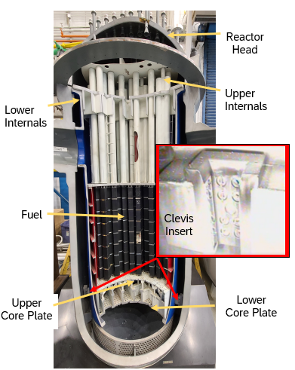
Clevis Bolt Replacement Project
Notes:
Objectives 2 and 5
The clevis insert attaches to the core support lug in the reactor vessel bottom head using high strength bolts and dowel pins.
The keyway in the clevis insert prevents the core barrel from turning.
16 of the 32 clevis bolts will be replaced. Then the decision will be made, based on outage activities, whether or not to remove the other 16.
Less dose rates compared to baffle bolts. Which RP fundamental could be used?
Radiological high risk per QF2010

Slide 2
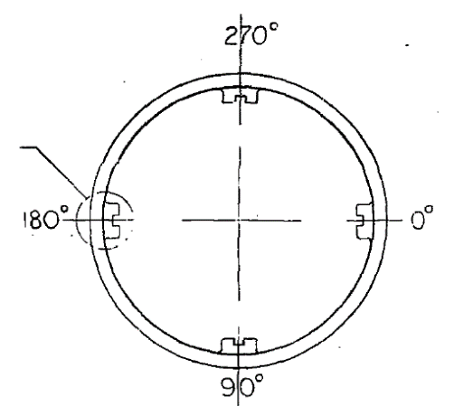
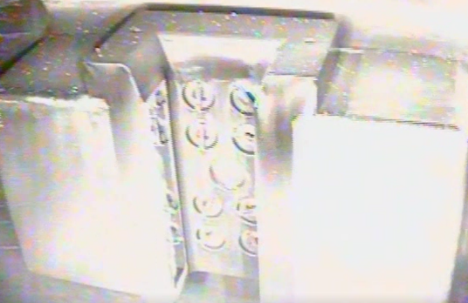
Clevis Bolt Replacement
RV Lug
Clevis Insert
Lock Bar
Dowel Pin
Clevis Bolt
Notes:
Objective 4
There have been multiple cases within the industry, where degradation has been found in the bolts that hold the Clevis Insert to the outer shell. The degradation is caused by primary water stress corrosion cracking. For this reason, Prairie Island (PI) will be one of the first plants in the industry replace Clevis bolts during 2R33 (Fall 2023) refueling outage, in parallel with our baffle bolt replacement.
There are 4 clevis inserts that are 90 degrees apart.
The plan is to replace the top 2 and bottom 2 bolts at each of the clevis insert locations. then if the decision is made to remove the additional 16, they will go back to each location to remove the inner 4 bolts.

Slide 3
Latest Industry Guidance
The following NEI 03-08 “Needed” guidance is effective at Westinghouse Designed PWR units as of July 1, 2023 or prior to 55 calendar years of plant operation – whichever comes first.
It is recommended that prior to this date the impacted utilities perform a review of this guidance for potential implementation.
Three different approaches are provided for flexibility in how to address the underlying issue, taking any one of these approaches would be considered as satisfying the guidance.

Slide 4
How is PI addressing Industry Guidance
New bolt hardware has been designed that is comprised of a cap screw and anti-rotation locking cup to replace the existing welded lock bar bolt system.
Per a Replacement Bolt Pattern Analysis (RBPA) it was determined that we need to replace 16 of the 32 bolts currently in place. If there is time, we will remove the additional 16 bolts.
A contingency bolt that is 5/8ths of an inch larger was also designed.
Notes:
Objective 4

Slide 5
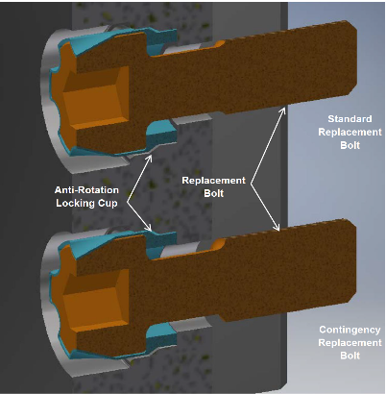
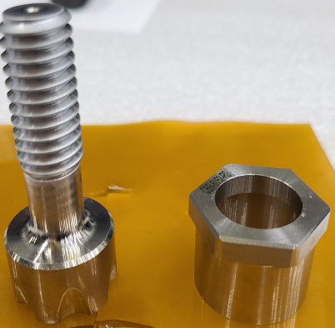
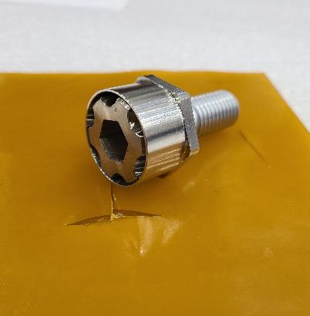
Replacement Bolt Design
Notes:
Objective 4
Instead of using a lock bar to ensure that the bolts will stay in place, the new bolts will utilize an anti-rotation locking cup that will be crimped around the head of the bolt

Slide 6
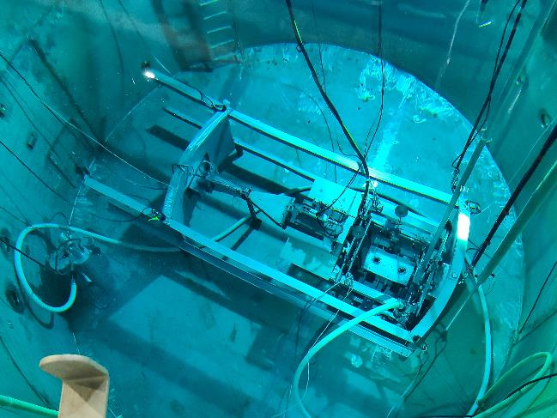
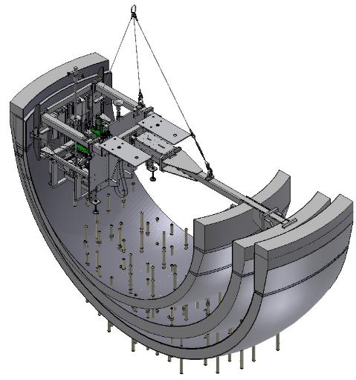
Docking Station
Notes:
Objective 4
Two axes of adjustment (X & Y) allow access to all clevis bolt positions (8) on a single clevis insert without repositioning the docking station.
Provides a common platform for all repair tooling. This component will be installed to span across 2 of the clevis inserts, the one that is 180 degrees from the insert to be worked. It should only be removed from the water at the end of the project, but it will be lifted several feet and rotated to a new position for each clevis insert (approx. 3 – 7 times). Moving the docking station requires it to be rigged to the Polar Crane and will require 2-part lifts to install down by clevises. When removing from reactor vessel, 755’ (Refuel Floor) to Upper Cavity, add additional wire rope lengths, Upper Cavity to Clevis Inserts.
Hydraulic functions
Opposing clamps – extend/retract the tool from clevis to clevis (180-deg opposite clevis)
Side Clamps – extend/retract side clamp cylinders to center the tool on the clevis insert
X-axis & Y-axis brake (engage / disengage)
Air operated functions:
Debris Basket (extend / retract)
Base plate clamps (lock/unlock)
Vacuum suction box swing arm (extend / retract)

Slide 7
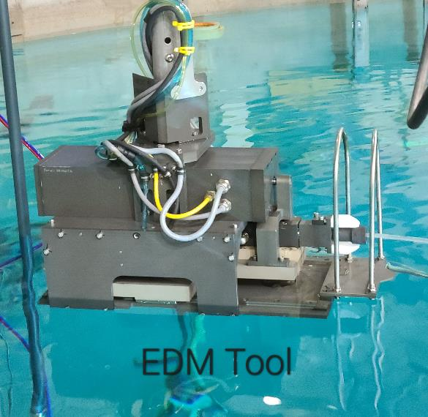
Westinghouse Proprietary Class 2
© 2023 Westinghouse Electric Company LLC. All Rights Reserved.
EDM Linear Cutting Head
The Electrical Discharge Machining (EDM) tool provides a means to machining various geometries in support of the clevis bolt repair process.
Standard Uses:
Cut #1 – Lock bar severing
Cuts #2 & #3 – Hex counterbore roughing with gimbal, PI design requires an additional extra roughing burn
Cut #4 – Hex counterbore finishing, with gimbal
Contingency EDM uses:
Bolt head removal, when the bolt cannot be un-torqued
5/16th inch internal hex, if there is a broken head or for bolt shank removal
Shank coring, to remove bolt shank and original threads
Oversize bolt diameter, for roughing and finishing cuts
Oversize bolt hex counterbore, no gimbal
78
Notes:
Objective 4

Slide 8
Bolt Replacement Process
The Alignment camera is used to align the main docking station platform to the specific clevis bolt to start work.
Sever the lock bar weld using EDM tool
Remove existing bolt
EDM the clevis insert to accept the replacement bolt and locking cup.
Verify existing threads are acceptable
Clean threads with the tap tool (contingency)
Install alignment mandrel using existing bolt threads
EDM Counterbore to final size and shape
Clean out hole with water jet and vacuum
Perform Visual Inspection to ensure no anomalies that could prevent hardware installation.
Install replacement bolt and locking cup
Perform final bolt torque and crimping of the locking cup.
Notes:
Objective 4

Slide 9
Radiological Considerations
Dose rates are expected to be 2 – 6 mr/hr on the Manipulator crane and Aux Bridge.
DC Cook replaced their Lower Radial Support Structure bolts 10 years ago, and documented a survey of the individual bolts with a range of 249 mr/hr / 8 mr/hr to 624 mr/hr / 11 mr/hr.
We will perform dose rates surveys of equipment underwater and at a foot above to verify that we do not remove any unwanted high dose rate material from the reactor cavity.
We will maintain control over the contamination, especially discrete radioactive particles that may be brought into work areas.
Notes:
Objectives 2 and 5
This will be the second time that this evolution has been done and the first time it will be done with Westinghouse.
Briefly review the current information listed in the RWP and ALARA Review. These documents should not be handed out to the trainees. The Instructor should emphasize that every time the trainees support this work, it is imperative that they review the current info.

Slide 10
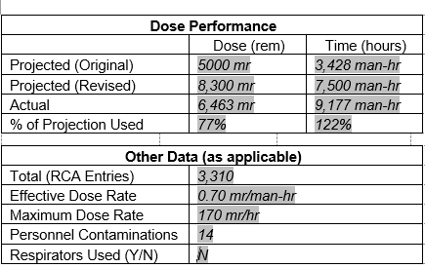
Post Job Info
Notes:
Objective 4

Slide 11
Baffle Bolt Replacement Project
During 2R33,
we replaced
299 Baffle Bolts
Notes:
Objectives 1 and 2
The majority of the bolts are projected to be replaced using the standard process, but Westinghouse has projected that they will need to use some contingency processes, using alternate tooling, that is already a part of the work scope, approved by Xcel Energy Outage Management for almost 1/3rd of the bolts. If these contingency processes are used, work delays will most likely occur and Xcel Energy would be informed. See subsequent slides for tooling required.
The baffle bolt project will be performed while the lower core barrel sits in the stand in the lower cavity.
Discuss which RP fundamental could be applied for removal of items from the water.

Slide 12
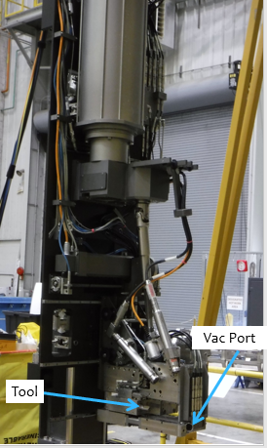
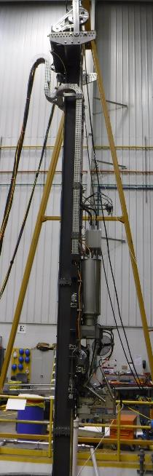
Mannheim Tool – Carriage and Mast
Mast
Carriage
The Mast consists of: a metal I-beam, the drive mechanism to move and operate the tool, and the carriage.
The Carriage is what the Baffle Bolt Tooling is attached to.
Vac Port
Notes:
Objective 4
The end effectors are installed and utilized by the Mannheim tool, which is essentially the carriage on a mast system.
The end effectors are attached to a “floating chuck”, which acts as a coupling between the tool and the carriage. The chucks are universal for all of the tools, with the FS-3 and FS-5 being the only 2 that have the “floating chuck” integrated into their housing.

Slide 13
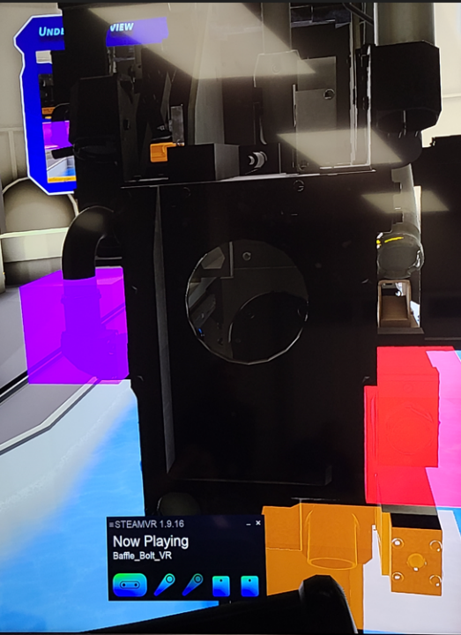
Mannheim Tool – Survey Points
Vac Elbow – on side of the carriage, natural location for fragments to get caught
Tool – This is where the End Effectors will be installed/changed out. Potential for there to be small fragments, especially from milling (FS-3) and counterbore cutting tool (FS-1).
Vac Suction – Primary source of suction, this will capture the most of the foreign material generated during the project.
Pencil Vac – vacuum suction can be diverted to pencil vac which will telescope out of the housing, into the hole to remove debris
Vac Elbow
Tool
Vac Suction
Pencil Vac
Notes:
Objectives 2 and 4
There is a potential for the vac hose to get some small pieces in them that are creating hot spots. The vac hose can be remotely diverted from the main suction to the pencil vac to allow for using the vac system to pull the debris causing the hot spots out of the carriage area. The vac will be cycled on and off to attempt to clear the sections that will come out with the tool.
Historically, the suction from the vacuum system has been enough to clear hot spots, but if not Westinghouse supervision will determine how to proceed. This is Westinghouse equipment and their guidance does not require Outage Management involvement unless radiological issues are identified with any Westinghouse decisions made. RP Supervision should be contacted if questions arise.
Milling operations can create long stringers of material that entwine themselves on the end effectors rather than small chips. The bridge techs and operators will work in conjunction with each other to ensure the foreign material is removed form the end effectors prior to RP surveys and disposed of in the baffle bolt trash cans. Long stringer “rats’ nests” should not be disposed of through the vac system, so they don’t get lodged in the hose.
Some chips that are generated will simply fall away in the a direction that will not be collected by the main vac, or are disturbed during periods where the main vac is off (e.g. guide stud retrieval) This is why Westinghouse has a stand alone vac operation at the end of the campaign that will clean the entirety of the work area.

Slide 14
Mechanical Work Bridge (MWB)
The Mast will be mounted on the Mechanical Work Bridge
Notes:
Objectives 2 and 4
The carriage is moved vertically on the mast by a computer program. They will have hard stops programed in at the 3 foot underwater and 1 foot above the water surface measurements required for the RP surveys.
The carriage moves quickly along the mast.
Briefly review the current information listed in the RWP and ALARA Review. These documents should not be handed out to the trainees. The Instructor should emphasize that every time the trainees support this work, it is imperative that they review the current info.

Slide 15
Radiological Considerations
Dose rates taken on the core barrel at other plants, in the areas of the baffle bolts, have been measured to exceed 100,000 Rem/hr.
There has been a history of issues with DRP’s in and around the work areas, including most of the personnel contaminations associated with Baffle Bolt work.
Several items have been determined to have dose rates that will prohibit them from being removed from the Rx Cavity. These items will be placed in underwater debris canisters and moved to the SFP via the Fuel Transfer System.
Notes:
Objectives 2 and 5

Slide 16
Expected Radiological Conditions:
Dose Rate on Bridge – 2 – 6 mr/hr
Tooling prior to rinse or hydrolase – up to 10 Rem/hr
Tooling when removed from the water – 40 – 800 mr/hr general area
Tools will be rinsed or hydrolazed under water prior to being surveyed
Tools will be placed in a bucket of water to be transferred from the bridge to the tool tent for final decon and maintenance.
Surveys in and around the work area, lifejackets or waistbelts, and items removed from the water will be very important for a successful project.
Notes:
Objectives 2 and 5
Orex ultras will be used for removal of any items from the cavity.

Slide 17
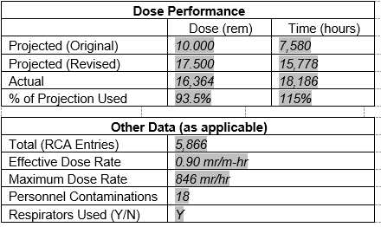
Post Job Info
Notes:
Objective 4

