Slide 1
Radiation Protection Resource Allocation
Bob French

Slide 2
Q.*Supply constraints of Radiation Protection Technicians
- Alignment of work within the radiologically controlled area with supporting Radiation Protection Technicians.
-Risk based decision making.

Slide 3
Use the work controls process to help !!!
Wolf Creek uses P6 as the scheduling tool.
P6 has user defined fields.
Two of these fields are assigned to identify risk: Dose Goal and RWP.
Planners resource work orders based upon Building-Location-Area (BLA).
ALL locations in the RCA are assigned an RP resource.
IF the planner perceives more are needed, they will assign multiple RP role ids.
ALARA team evaluates the work and craft, assigns RWPs, and assigns (projected) dose goals.
(Dose goals are projections NOT dose ESTIMATES)

Slide 4
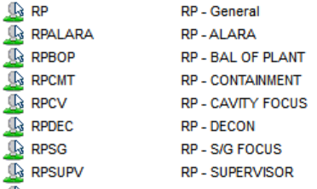
Define Resources within Work controls
Our Role ID in P6 is “RP” RP-General to be specific.
The RP resource structure is further defined as:

Slide 5
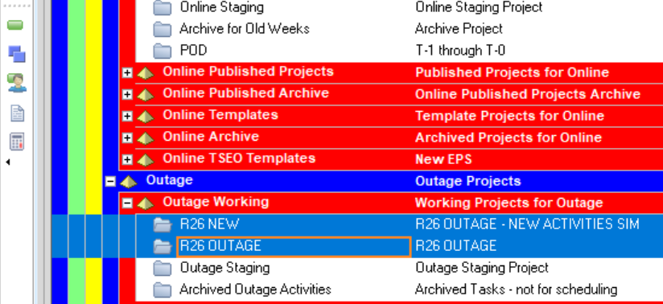
RP Industry Task Force
To set up Resource allocation I have the targeted Project open as well as the activities selected. For me it looks like this:

Slide 6
First phase set up:
I ensure the columns I want are aligned, for me that is Dose Goal, RWP, Activity name, Role IDs and BLA. My overall set up looks like this:

Slide 7
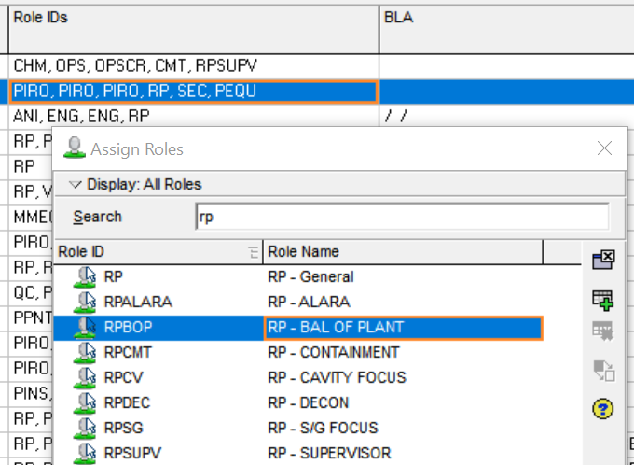
First phase
The goal is to align the proper resource and level.
Filter on “RP” to generate the report.
The highlighted activity is for removing a portion of RCA fencing.
RWP is general
Minimal dose
1 RP technician is assigned in the role ID
I assign RPBOP and remove the RP-General role.
Save the work and the resource is now assigned to RPBOP.
This lets me know this step is done. The next phase will further align the resource.

Slide 8
First phase cont.
We now see a report filtered on RPBOP
The same activity is highlighted as before with the Details listed and Resources tab selected (in the details field).
This activity shows the resources assigned to support this work.
The duration for this work is 2 hours.
Each resource is listed at 1.0/h = 100% of the time for the resource.
This means that each role (resource) is allocated 100% time per unit.
12 man-hours are required for the 2-hour job.
This activity is a low-risk activity. However, it is a Radiological Controlled Area boundary breach.
The RP technician must control the area and work then restore postings when work is complete.
I will not alter the RP technicians time, based upon the posting and control Risks.
Roles such as Decon can be added and the timeline adjusted so 25% of the total time is applied to this role.
This allows for set up or tear down of an area or additional Decon presence.

Slide 9
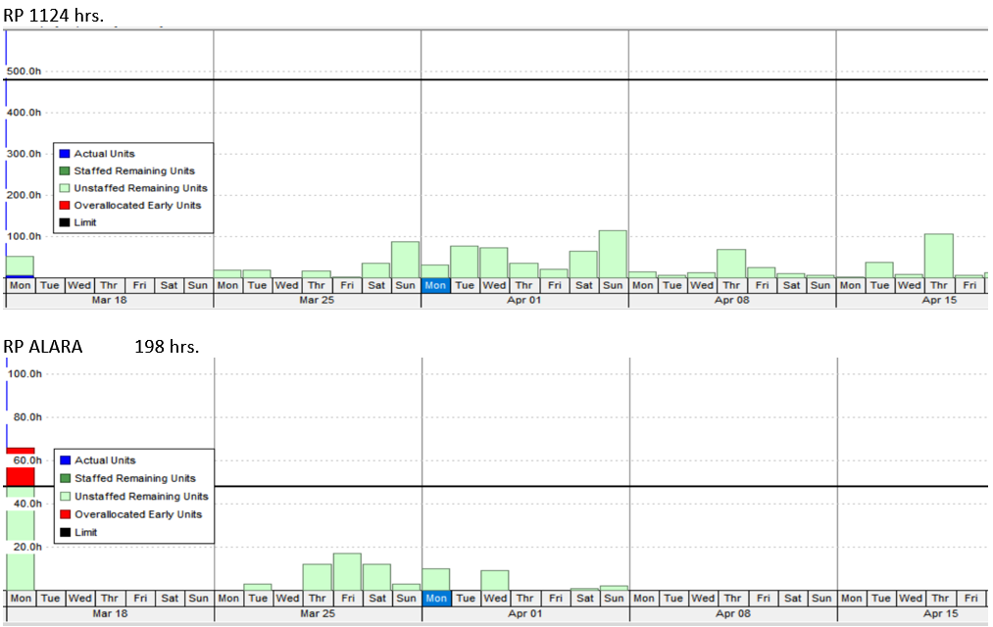
Why all the work focused on this level? Here are some of the downstream effects.

Slide 10
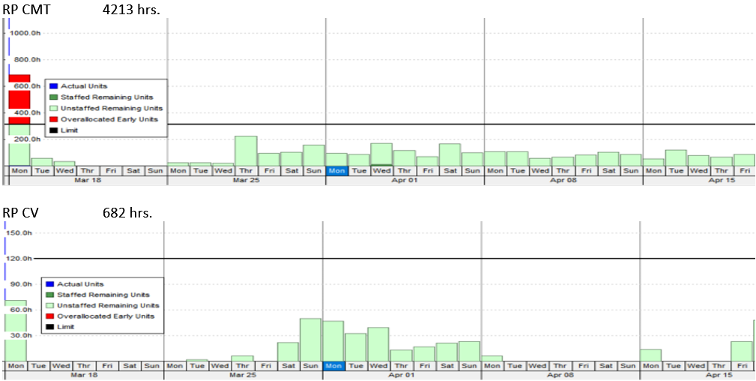
Downstream effects cont.

Slide 11
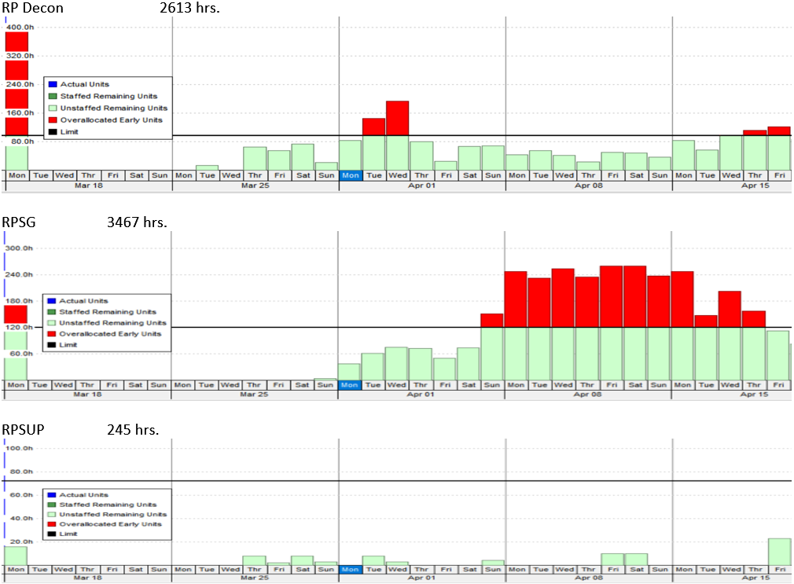
Downstream effects cont.

Slide 12
Downstream effects Summary
Resource loads provide insight for a time that could tax RP resources, allowing for staffing adjustments beforehand.
Resources can be further aligned within the scheduled item by assigning the allotted percentage of RP hours associated with that task.
Hours-per-Role category allows break out of work and resources.
A few things to consider:
Analysis of overload time frames may reveal overlapping work orders or redundant work.
Grouping work by work area creates an overview of what is happening within the area.
Assigning RP technician to an area that includes the complement of work rather than assigning technicians per work order-crew.
Is the activity covered cradle to grave? Decon, set up – clean up ?
Graphs highlight challenging shifts and allow staffing to be realigned through the Outage Control Center (moving technicians from one area to another).
On a larger scale the graphs provide Coverage Hours that can be interpolated into overall outage/Project work loading for Radiation Protection.
Assigned shifts, break times, and work areas all factor into the actual hours needed. The current hours indicated are those the craft project for the activity NOT what may be needed for Radiation Protection support.

Slide 13
In closing
There are a lot of ways to accomplish our tasks.
Risk at the forefront.
This is just a snapshot of a process that exists at all our utilities that can be utilized.
Questions?

