Slide 1
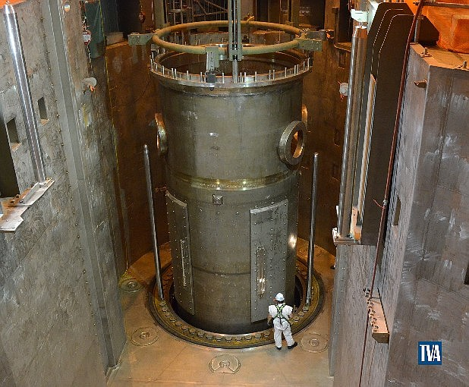
Rx 10 Year ISI and
Clevis Bolt Replacement
what it is and what to expect

Slide 2
Objectives
10 Year ISI
  Purpose
  Summary of Inspections
  Additional Inspections
  Inspection Process
  Lessons Learned
Clevis Bolt Replacement
  Purpose/Industry Guidance
  Replacement Process and Tooling
  Radiological Considerations
  Lessons Learned

Slide 3
10-Year ISI
Purpose
Periodic inspection of the Rx Vessel, Lower Internals, and Upper Internals to determine condition of bolts, welds, and wear components.
Combination of visual and ultrasonic tests
Owned by site engineering, but typically contracted out to a vendor
  Infrequently performed
  Specialized equipment
Some inspection requirements within 10-Year ISI program have 20-year periodicity due to program revisions
  Last inspection may be different from upcoming inspection

Slide 4
10-Year ISI
Inspections
Rx Vessel ISI
  VT exams via mini-sub
  UT exams via robot
  VT of interior and exterior surface
  VT of core support structure
  UT of pressure retaining welds
  UT of HL and CL nozzle welds
  VT of interior welded attachments
  VT of nozzle interior radius
  VT of welded core support structure
    includes components of Upper and Lower Internals

Slide 5
10-Year ISI
Additional Inspections – MRP 227 VT Exams
Guide Tube upper and lower flange welds
Core Barrel upper and lower girth welds
Core Barrel middle and lower axial welds
Thermal Shield Support Block Bolts (top of core barrel)
Core Barrel Thermal Shield Flexures (bottom of core barrel)
Upper Internals core plate
Clevis insert bolts
Lower core plate fuel alignment pins
Baffle assembly and baffle-edge bolts

Slide 6
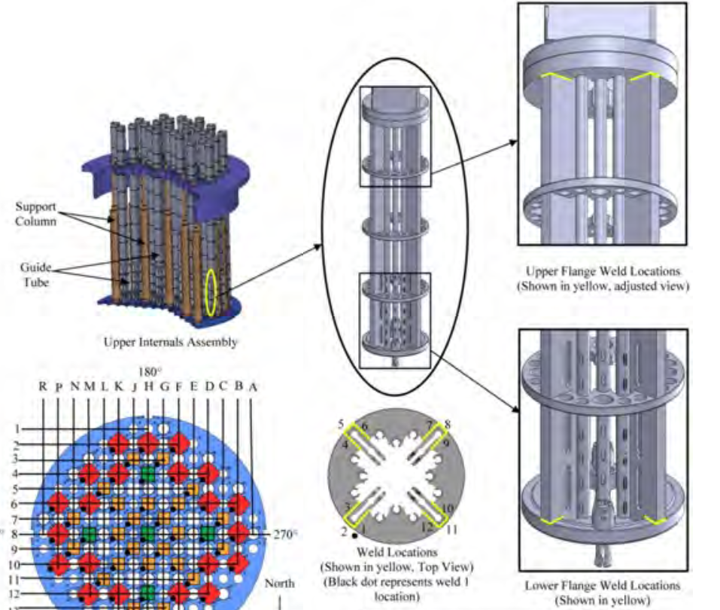
10-Year ISI
Additional Inspections – MRP 227
Upper and Lower Flange Welds

Slide 7
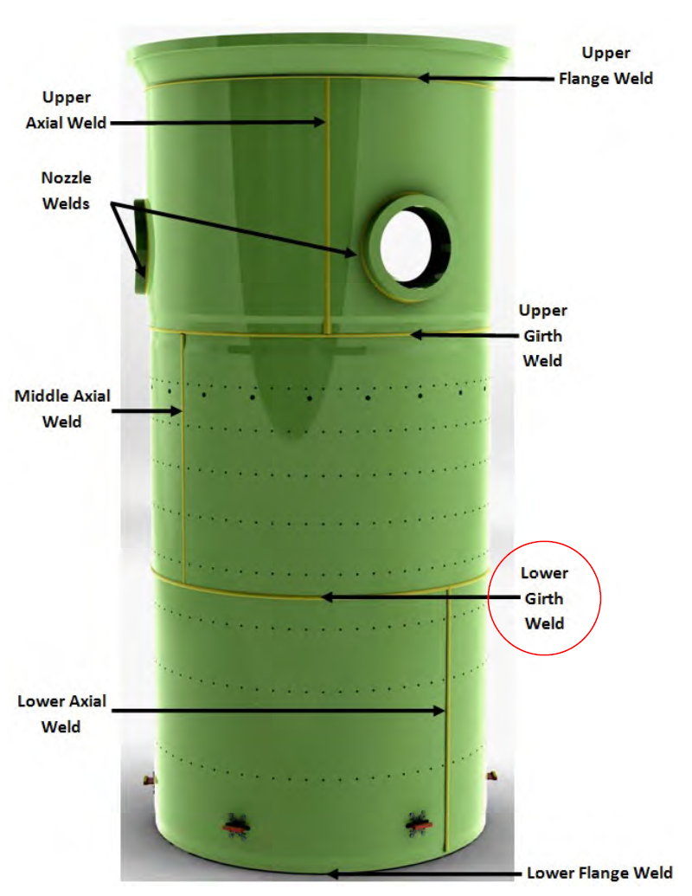
10-Year ISI
Additional Inspections – MRP 227
Core Barrel upper and lower girth welds
Core Barrel middle and lower axial welds

Slide 8
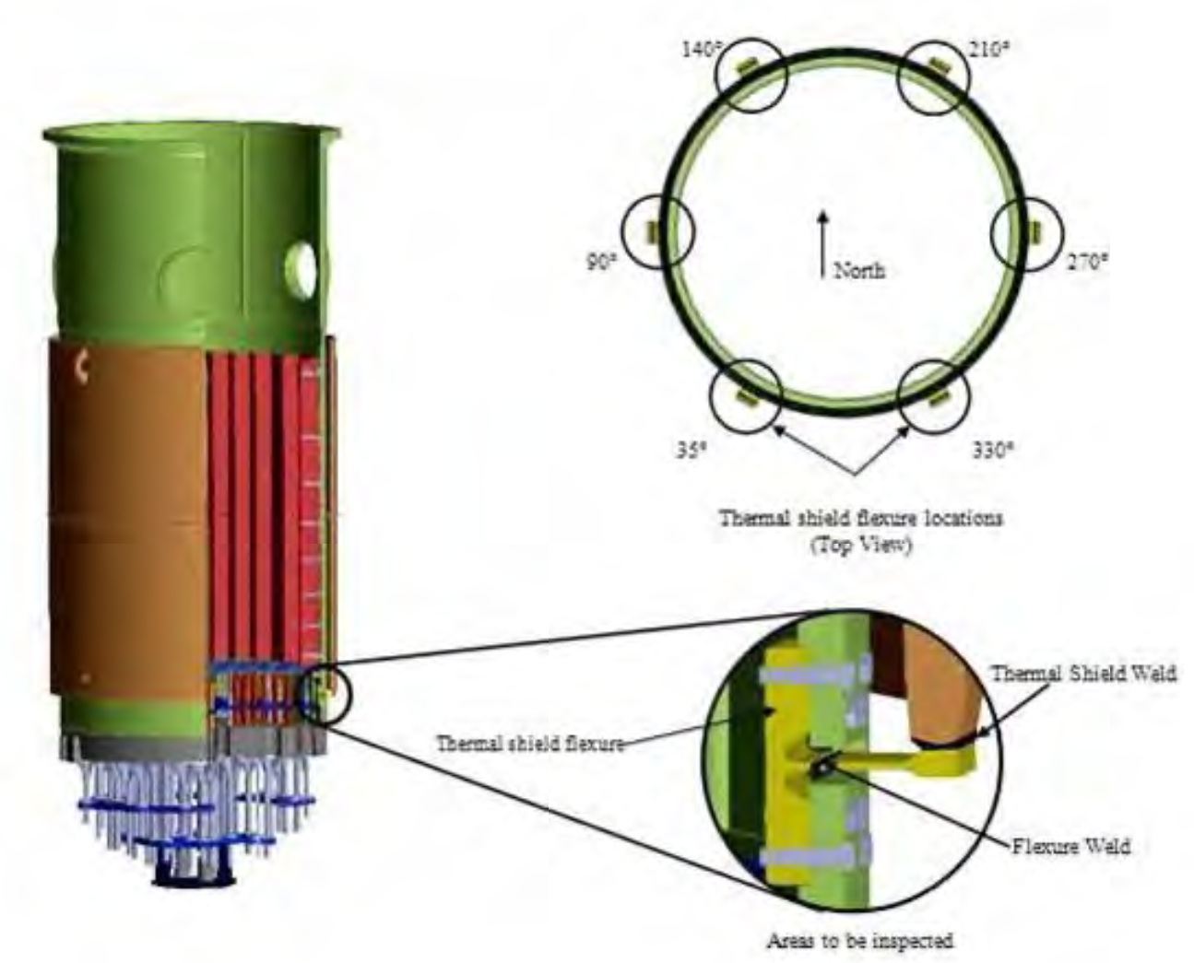
10-Year ISI
Additional Inspections – MRP 227
Thermal Shield Support Block Bolts (top of core barrel)
Core Barrel Thermal Shield Flexures (bottom of core barrel)

Slide 9
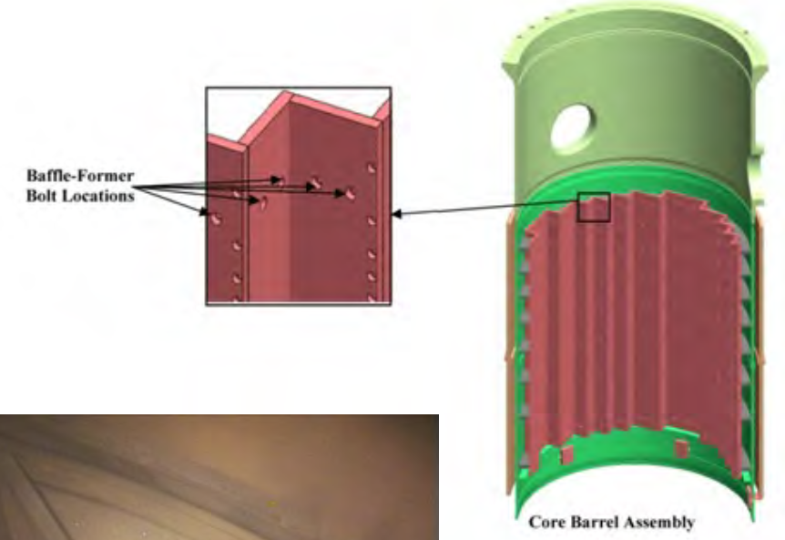
10-Year ISI
Additional Inspections – MRP 227
Baffle assembly and baffle-edge bolts

Slide 10
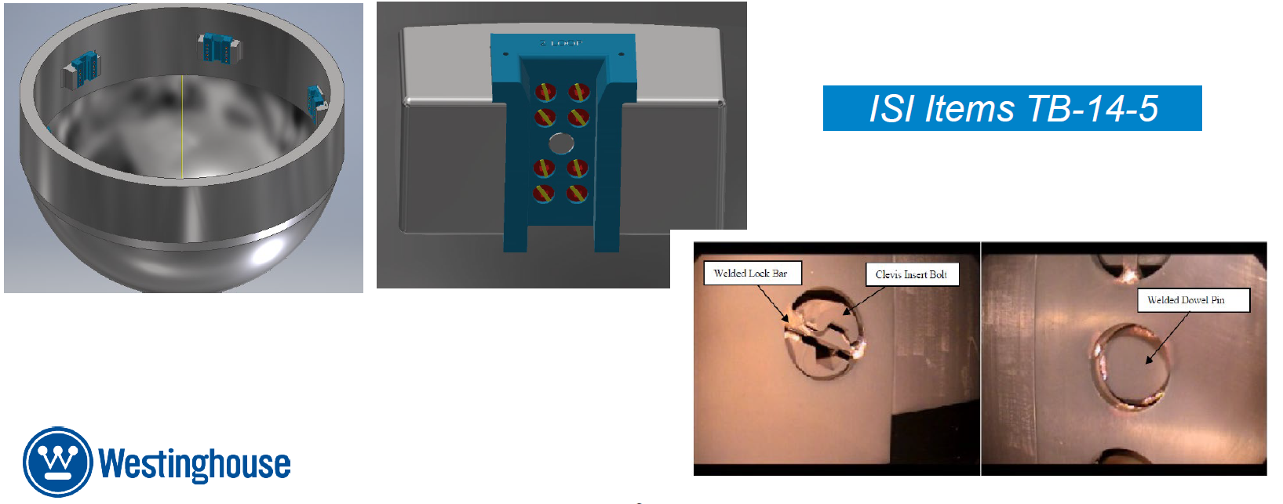
10-Year ISI
Additional Inspections – Clevis Bolt UT Exams
UT Clevis Insert bolts and dowel pin
  6 equally spaced supports around the Rx Vessel just above the lower dome
  Supports/aligns the lower core barrel

Slide 11
10-Year ISI
Inspection Process
Rx Vessel inspections performed using Refueling Bridge
Upper/Lower Internals inspections performed in Equipment Pit using temporary Aux Bridge
Laydown area established near Rx Cavity for tool and end-effector changes
Shielding on floor of Aux Bridge
  Reduced dose rates to 5 mrem/hr (vs unshielded 10-20 mrem/hr)
RVISI inspections with robot/mini-sub deployed into Rx Cavity water, inspections performed remotely
Most MRP-227 inspections performed with long-handled tools from Aux Bridge
Clevis Bolts inspections with long-handled tool to deploy UT probe

Slide 12
10-Year ISI
Radiological Considerations
Mini-sub inspections of suspended Core Barrel
Dislodging radioactive material from Rx surfaces
Removing tools/robots from Rx Cavity water
Changing robot tools that have been in contact with Rx surfaces
  2,000,000 dpm/100cm² prior to decon
RCA hour management above the Rx Cavity

Slide 13
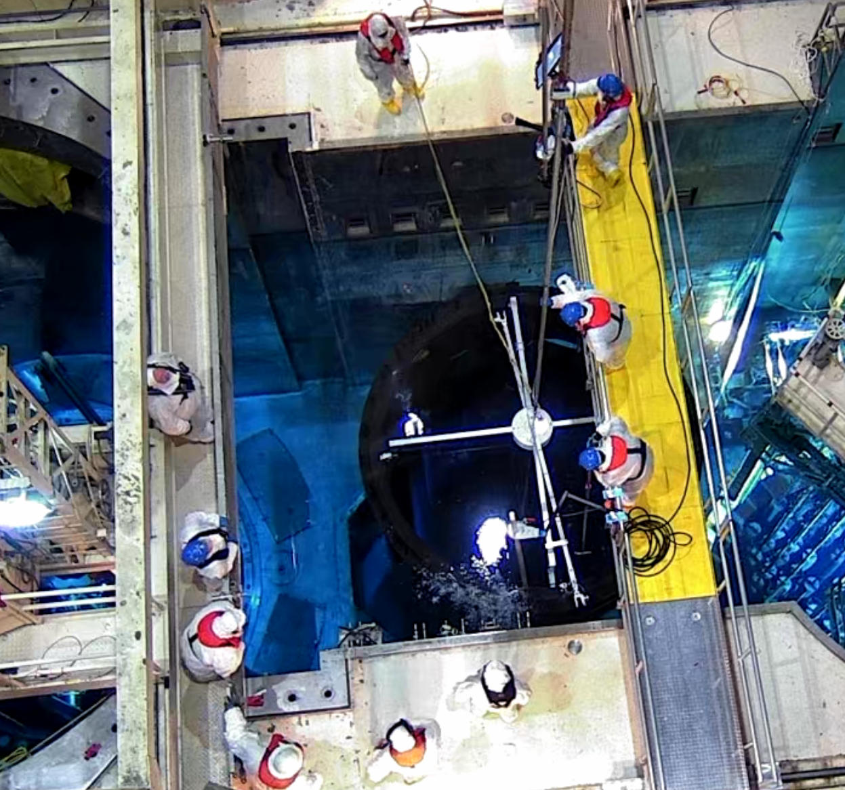
10-Year ISI
Lessons Learned
Estimate: 1.300 REM / 843 Hours
Actual: 3.189 REM / 2,539 Hours
Significantly underestimated support personnel
Delayed planning input from vendor
Clevis Bolt as-built discrepancies required troubleshooting and tool modification
Software difficulties when changing tools
Poor communication from work group to site (including ALARA) during challenges
Bubbles from Tri-Nuke collected on cameras and inspection locations
 | REM |  | Hours
Work Description | Inspection | Support | Inspection | Support
10 Year Rx Vessel ISI – Visual and UT | 1.079 | 0.889 | 768 | 961
MRP-227 Inspection | 0.862 | 0.049 | 490 | 74
Clevis Bolt Inspection | 0.095 | 0.215 | 46 | 200
Totals: | 2.036 | 1.153 | 1,304 | 1,235

